Slide 1
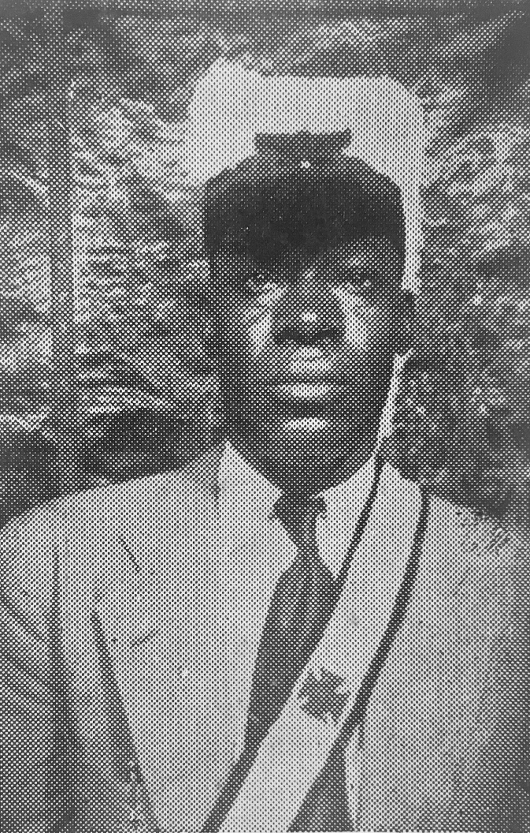
73rd BIENNIAL SESSION United Supreme Council
WELCOME TO TEXAS
August 12th 1966
ILL. Jesse Thomas 33°

